Slide 1
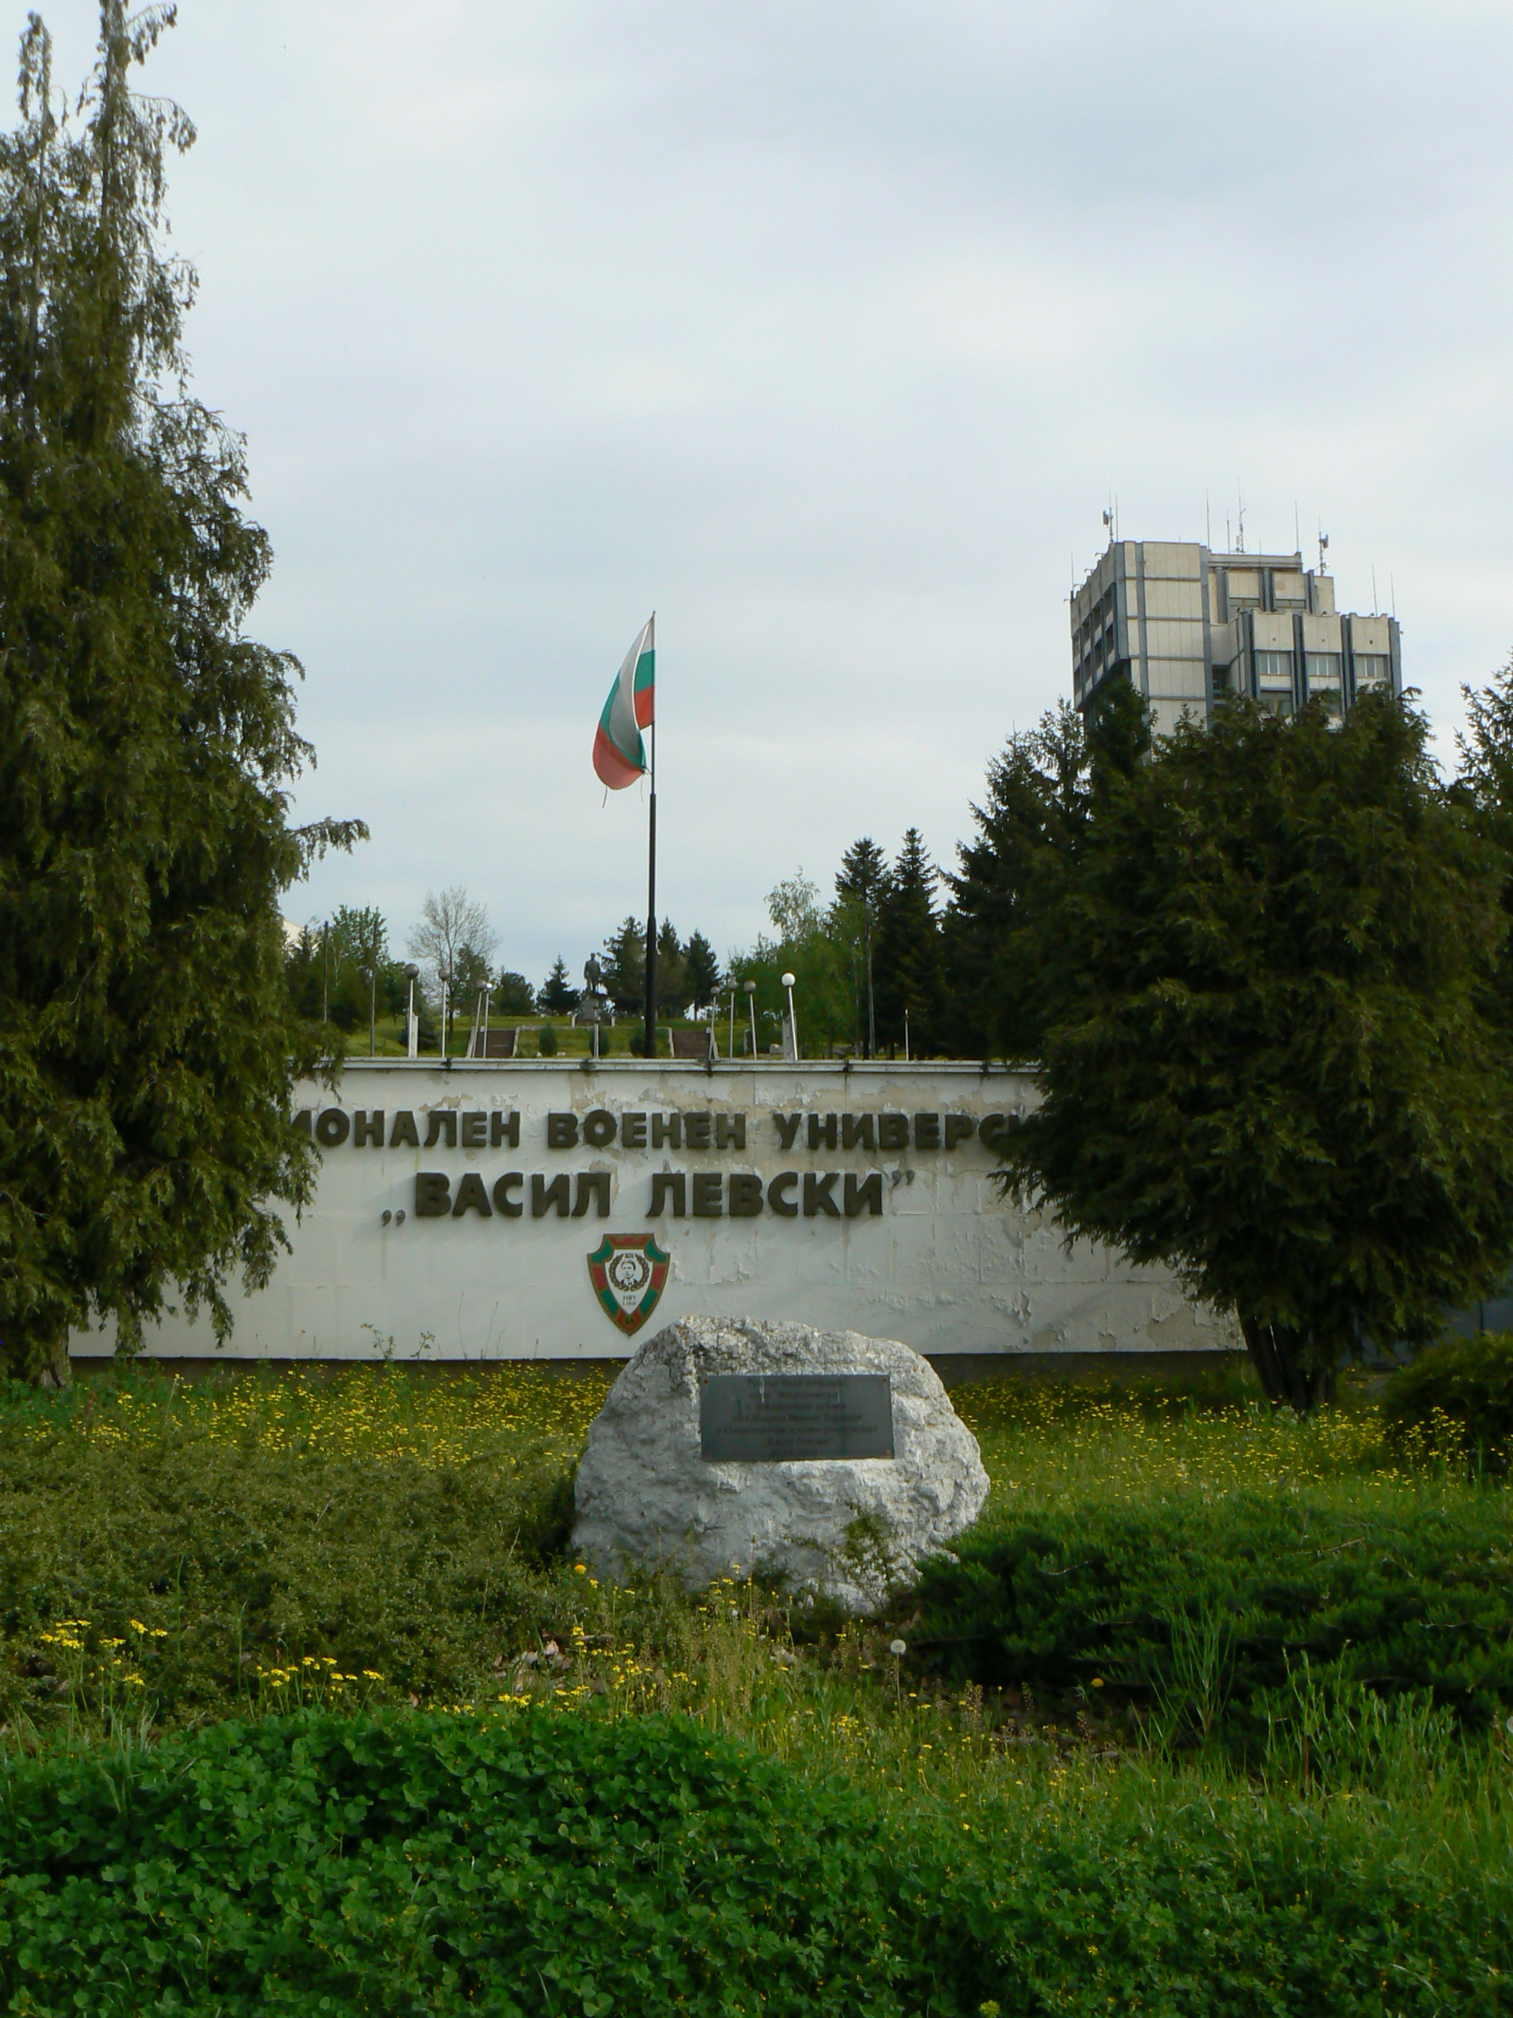
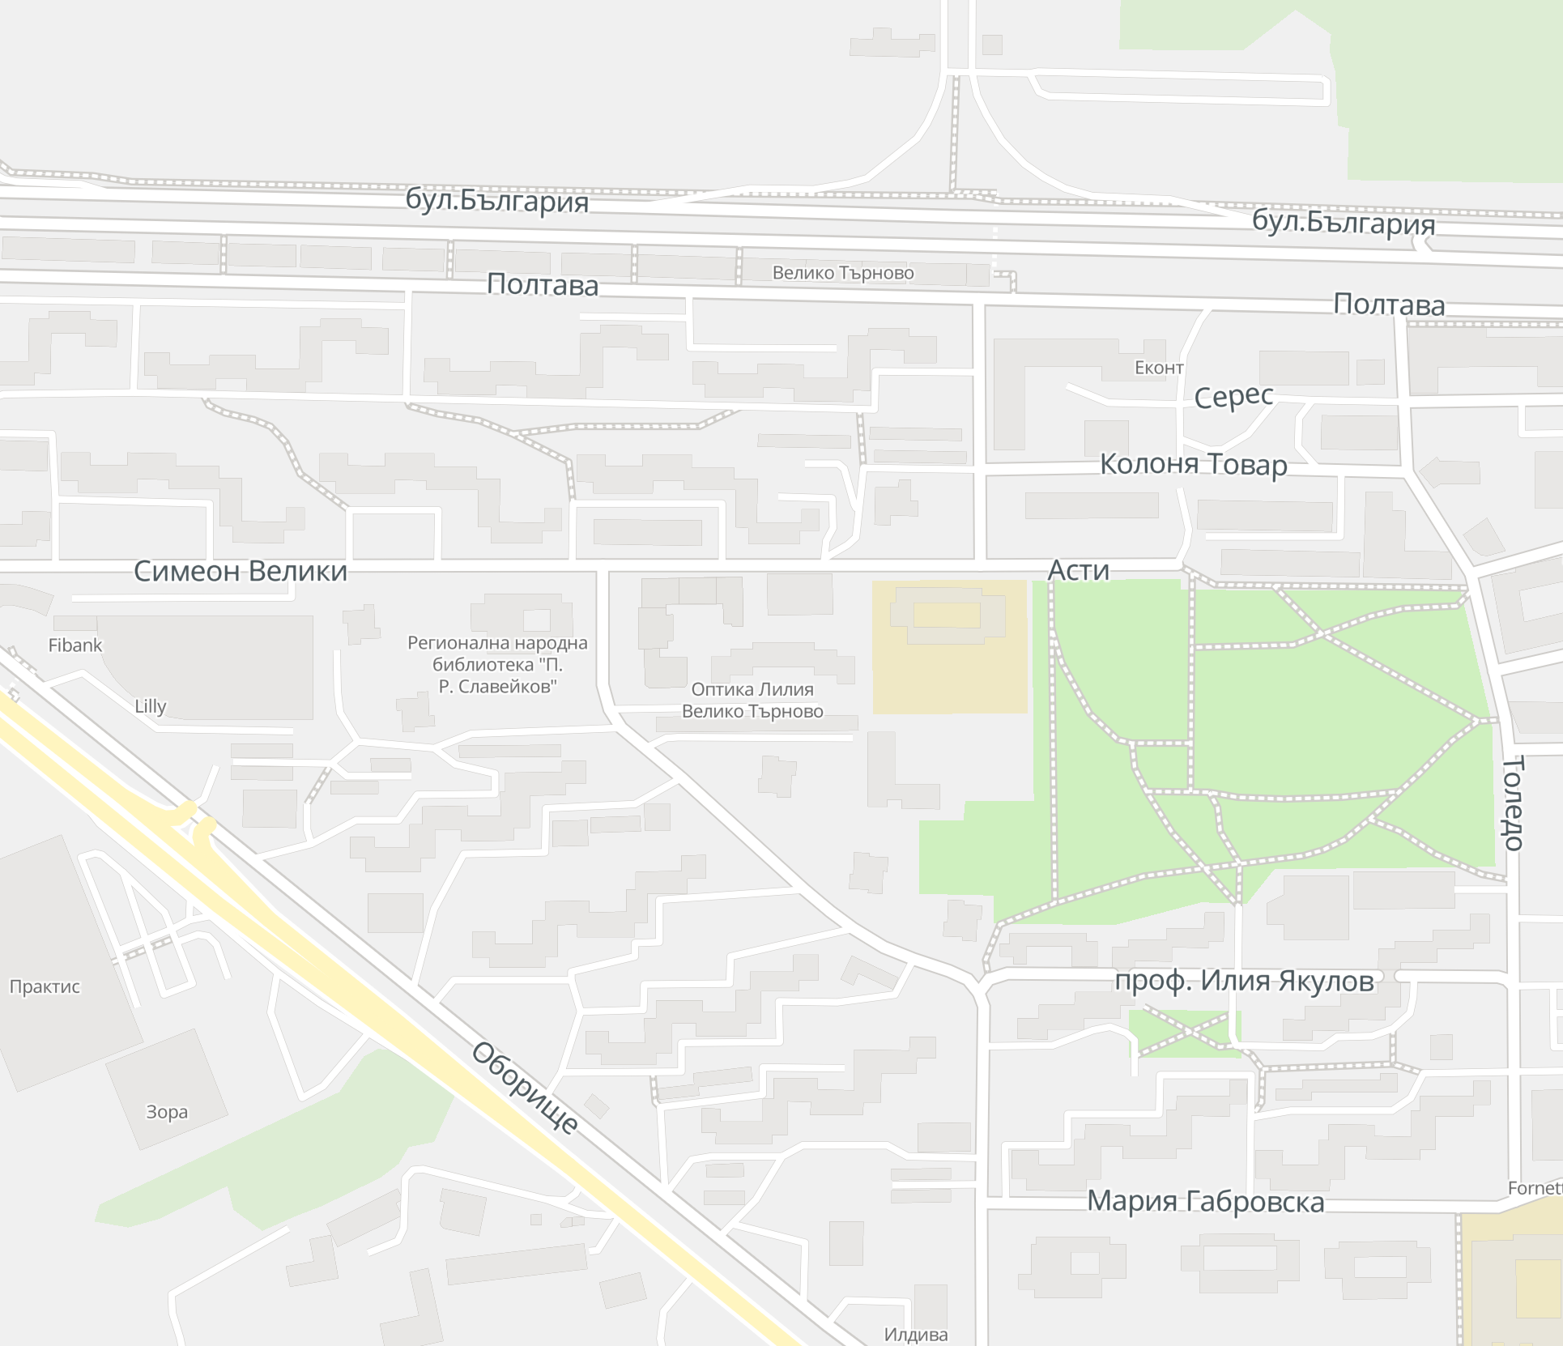

The Title of the Paper in International Scientific Conference Secure Systems Design and Technology Development (30 point font, bold letters)
ID: XXXX
Names of the Authors (24 point font, bold letters)
Authors’ Affiliation(s) (20 point font)
Abstract (22 point font, bold letters)
All papers submitted to the SysTechDev2026 are also required to be displayed as posters even the papers have been assigned as oral presentation. Please use this document as a template to form the poster in which you can type your own text. (17
point font, single-spaced) and paste figures.
Keywords (22 point font, bold letters)
IEEE; SysTechDev2026; Security. (one line if possible)
IV. Experiments
The International Scientific Conference Secure Systems Design and Technology Development (SysTechDev2026) will be held from 25 to 26 June 2026 in ''Vasil Levski'' National Military University, Veliko Tarnovo, Bulgaria. SysTechDev2026 is cosponsored by the Estonian University of Lifesciences, Estonia, and Vidzeme University of Applied Sciences, Latvia.
The contributed and accepted papers to the SysTechDev conferences will all be published in their proceedings.
I. Introduction (22 point font, bold letters )
This is the template for preparation of posters for 2026 International Conference on Secure Systems Design and Technology Development
(SysTechDev2026). Please use this document as a sample of the conference poster.
SysTechDev2026 will produce final hard copies of all poster papers in a unified style. The PowerPoint template to produce your conference posters is available at
https://etrconf.eu/event/1/
All the papers accepted poster presentation MUST have their posters presented in SysTechDev2026. Please prepare your poster with this template, and then email back to: n_dolchinkov@abv.bg
II. Principle (22 point font, bold letters )
Describe the basic principle of your research works here.
The scope of the conference includes principally the following topics:
DEFENSE AND SECURITY TECHNOLOGY
ENGINEERING SCIENCES AND PRODUCTION TECHNOLOGY
INFORMATION TECHNOLOGY
LASER TECHNOLOGY
SUSTAINABLE ENERGY ENGINEERING AND APPLICATIONS
Fig. 3. Vasil Levski National Military University, Bulgaria.
III. Theoretical Modelling
This is the template for preparation of posters for SysTechDev2026. Please use this
document as a sample of the conference poster.
V. Results and Analyses
There are many hotels surrounding the Vasil Levsky National Military University, 76 Bulgaria Boulevard 5000, Veliko Tarnovo, Bulgaria
SysTechDev2026 will not make contract-hotels for participants
A. Template of Font (20 point font)
All the items in your poster should be presented as an uniform layout. Do NOT
change the font sizes and font colors in the template.
Move the mouse to the beginning of the last column of each paragraph, press the key of “Enter” to interrupt the last column, and then make it LEFT align.
Other columns in each paragraph are recommended to be JUSTIFY align.
B. Template of Figures and Tables
More Figures and Tables are preferred for your poster to present your
outstanding works in SysTechDev2026.
Try to make your Figures are transparent to suit the light-yellow
background of the poster. In addition, all the items in the Figures and Tables such as lines, words, symbols are recommended to be identical to the colour of the
TEXT in the template (dark green)
(1)
(2)
Fig. 4. Title of the Figure. (16 point font)
VI. Conclusion
1. Technical Tours
2. Post Conference Tours
(Detailed information will be updated later)
Fig. 1. Title of the Figure. (16 point font)
Fig. 2. Title of the Figure. (16 point font)
Table I. Heading of the Table. (16 point font)
Model | Feature extraction | Reprocessing | Classification
KNN | >200,000 flops | ~10 flops | ~200 flops
NN |  |  | ~10,000 flops
References (Optional)
[1] X.Y. Cole, Enter main references here, SysTechDev2026, Jun. 25-26, 2026.
[2] X.Y. Cole, How to prepare the poster in SysTechDev, vol. 3, no. 1, pp. 1-4, 2026.
• Enter your acknowledgements or sponsors here. (Optional) (14 point font)
Author email: XXX@XX.XX
International Scientific Conference Secure Systems Design and Technology Development. Veliko Tarnovo, Bulgaria, 25-26 June 2026

